Slide 1
Module 3 Multi-Entity Modeling and SQL
Ling Xue

Slide 2
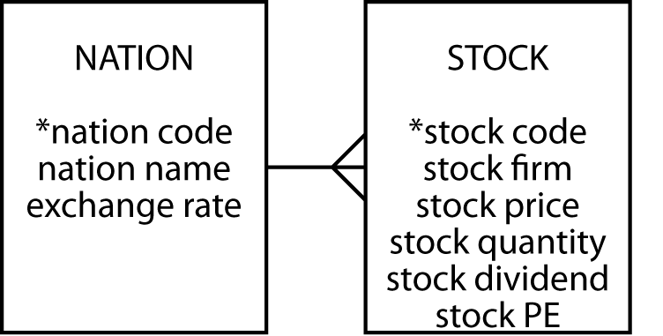
The one-to-many relationship
Entities are related to other entities
A 1:m relationship
Read as: ‘a nation can have many stocks, but a stock belongs to only one nation’

Slide 3
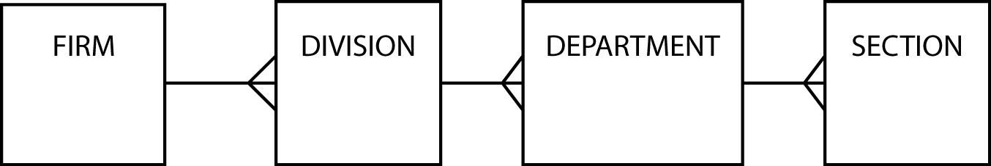
Hierarchical relationships
Occur frequently
Multiple 1:m relationships

Slide 4
Could create STOCK table with additional columns (but note redundancy of natname and exchrate)
stock
stkcode | stkfirm | stkprice | stkqty | stkdiv | stkpe | natname | exchrate
FC | Freedonia Copper | 27.50 | 10529 | 1.84 | 16 | United Kingdom | 1.00
PT | Patagonian Tea | 55.25 | 12635 | 2.50 | 10 | United Kingdom | 1.00
AR | Abyssinian Ruby | 31.82 | 22010 | 1.32 | 13 | United Kingdom | 1.00
SLG | Sri Lankan Gold | 50.37 | 32868 | 2.68 | 16 | United Kingdom | 1.00
ILZ | Indian Lead &Zinc | 37.75 | 6390 | 3.00 | 12 | United Kingdom | 1.00
BE | Burmese Elephant | .07 | 154713 | 0.01 | 3 | United Kingdom | 1.00
BS | Bolivian Sheep | 12.75 | 231678 | 1.78 | 11 | United Kingdom | 1.00
NG | Nigerian Geese | 35.00 | 12323 | 1.68 | 10 | United Kingdom | 1.00
CS | Canadian Sugar | 52.78 | 4716 | 2.50 | 15 | United Kingdom | 1.00
ROF | Royal Ostrich Farms | 33.75 | 1234923 | 3.00 | 6 | United Kingdom | 1.00
MG | Minnesota Gold | 53.87 | 816122 | 1.00 | 25 | USA | 0.67
GP | Georgia Peach | 2.35 | 387333 | .20 | 5 | USA | 0.67
NE | Narembeen Emu | 12.34 | 45619 | 1.00 | 8 | Australia | 0.46
QD | Queensland Diamond | 6.73 | 89251 | .50 | 7 | Australia | 0.46
IR | Indooroopilly Ruby | 15.92 | 56147 | .50 | 20 | Australia | 0.46
BD | Bombay Duck | 25.55 | 167382 | 1.00 | 12 | India | 0.0228

Slide 5
Create another entity (to avoid anomalies listed below)
Insert
Cannot insert a fact about a nation’s exchange rate without buying a stock listed with that nation
Separate table solves this problem
Delete
If delete data about a particular stock, may lose exchange rate data
Update
Increase number of updates required, and possibility of error

Slide 6
Mapping to a relational database
Each entity becomes a table
The entity name becomes the table name
Each attribute becomes a column
Add a column to the table at the many end of a 1:m relationship
Put the identifier of the one end in the added column

Slide 7
NATION and STOCK (note that natcode appears in both tables)
nation
natcode | natname | exchrate
UK | United Kingdom | 1.00
USA | United States | 0.67
AUS | Australia | 0.46
IND | India | 0.0228
stock
stkcode | stkfirm | stkprice | stkqty | stkdiv | stkpe | natcode
FC | Freedonia Copper | 27.50 | 10529 | 1.84 | 16 | UK
PT | Patagonian Tea | 55.25 | 12635 | 2.50 | 10 | UK
AR | Abyssinian Ruby | 31.82 | 22010 | 1.32 | 13 | UK
SLG | Sri Lankan Gold | 50.37 | 32868 | 2.68 | 16 | UK
ILZ | Indian Lead &Zinc | 37.75 | 6390 | 3.00 | 12 | UK
BE | Burmese Elephant | .07 | 154713 | 0.01 | 3 | UK
BS | Bolivian Sheep | 12.75 | 231678 | 1.78 | 11 | UK
NG | Nigerian Geese | 35.00 | 12323 | 1.68 | 10 | UK
CS | Canadian Sugar | 52.78 | 4716 | 2.50 | 15 | UK
ROF | Royal Ostrich Farms | 33.75 | 1234923 | 3.00 | 6 | UK
MG | Minnesota Gold | 53.87 | 816122 | 1.00 | 25 | USA
GP | Georgia Peach | 2.35 | 387333 | .20 | 5 | USA
NE | Narembeen Emu | 12.34 | 45619 | 1.00 | 8 | AUS
QD | Queensland Diamond | 6.73 | 89251 | .50 | 7 | AUS
IR | Indooroopilly Ruby | 15.92 | 56147 | .50 | 20 | AUS
BD | Bombay Duck | 25.55 | 167382 | 1.00 | 12 | IND

Slide 8
Foreign keys
Foreign key – a column (or combination of columns) in one table whose values must match the primary key in the same table, or the primary key in another table, or be null
natcode in stock is a foreign key because natcode is the primary key of nation
Record a 1:m relationship

Slide 9
Referential integrity constraint
For every value of a foreign key there is a primary key with that value
For every value of natcode in stock there is a value of natcode in nation
A primary key must exist before the foreign key can be defined
Must create the nation record before records for stocks listed in that nation are created

Slide 10
Creating the tables
CREATE TABLE nation (
natcode CHAR(3),
natname VARCHAR(20),
exchrate DECIMAL(9,5),
PRIMARY KEY (natcode));

Slide 11
Creating the tables
CREATE TABLE stock (
stkcode CHAR(3),
stkfirm VARCHAR(20),
stkprice DECIMAL(6,2),
stkqty DECIMAL(8),
stkdiv DECIMAL(5,2),
stkpe DECIMAL(5),
natcode CHAR(3),
PRIMARY KEY(stkcode),
CONSTRAINT fk_has_nation FOREIGN KEY(natcode)
REFERENCES nation(natcode) ON DELETE RESTRICT);

Slide 12
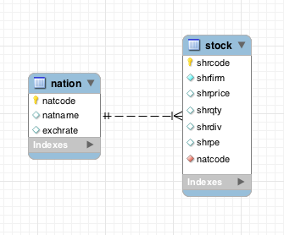
Representing a 1:m relationship in MySQL Workbench
A non-identifying relationship in MySQL Workbench
An identifying relationship means that the child table cannot be uniquely identified without the parent

Slide 13
Exercise
Develop a data model to keep track of a distance runner’s times over various lengths
Create the database and add 3 rows for each of 2 athletes

Slide 14
Join Two Tables
Inner Join
Retrieve records from both the left table and the right table that satisfy a join condition
Outer Join: Left Join
Retrieve records from both the left table and the right table that satisfy a join condition
And retrieve all the remaining records from the left table
Outer Join: Right Join
Retrieve records from both the left table and the right table that satisfy a join condition
And retrieve all the remaining records from the right table
Full Join
Retrieve all the records from the two tables and put them together

Slide 15
Join
Create a new table from two existing tables by matching on a common column
SELECT * FROM stock JOIN nation
ON stock.natcode = nation.natcode;
stkcode | stkfirm | stkprice | stkqty | stkdiv | stkpe | natcode | natcode | natname | exchrate
NE | Narembeen Emu | 12.34 | 45619 | 1.00 | 8 | AUS | AUS | Australia | 0.46000
IR | Indooroopilly Ruby | 15.92 | 56147 | 0.50 | 20 | AUS | AUS | Australia | 0.46000
QD | Queensland Diamond | 6.73 | 89251 | 0.50 | 7 | AUS | AUS | Australia | 0.46000
BD | Bombay Duck | 25.55 | 167382 | 1.00 | 12 | IND | IND | India | 0.02280
ROF | Royal Ostrich Farms | 33.75 | 1234923 | 3.00 | 6 | UK | UK | United Kingdom | 1.00000
CS | Canadian Sugar | 52.78 | 4716 | 2.50 | 15 | UK | UK | United Kingdom | 1.00000
FC | Freedonia Copper | 27.50 | 10529 | 1.84 | 16 | UK | UK | United Kingdom | 1.00000
BS | Bolivian Sheep | 12.75 | 231678 | 1.78 | 11 | UK | UK | United Kingdom | 1.00000
BE | Burmese Elephant | 0.07 | 154713 | 0.01 | 3 | UK | UK | United Kingdom | 1.00000
ILZ | Indian Lead & Zinc | 37.75 | 6390 | 3.00 | 12 | UK | UK | United Kingdom | 1.00000
SLG | Sri Lankan Gold | 50.37 | 32868 | 2.68 | 16 | UK | UK | United Kingdom | 1.00000
AR | Abyssinian Ruby | 31.82 | 22010 | 1.32 | 13 | UK | UK | United Kingdom | 1.00000
PT | Patagonian Tea | 55.25 | 12635 | 2.50 | 10 | UK | UK | United Kingdom | 1.00000
NG | Nigerian Geese | 35.00 | 12323 | 1.68 | 10 | UK | UK | United Kingdom | 1.00000
MG | Minnesota Gold | 53.87 | 816122 | 1.00 | 25 | US | US | United States | 0.67000
GP | Georgia Peach | 2.35 | 387333 | 0.20 | 5 | US | US | United States | 0.67000

Slide 16
Join
Report the value of each stock holding in UK pounds. Sort the report by nation and firm.
SELECT natname, stkfirm, stkprice, stkqty, exchrate,
stkprice*stkqty*exchrate AS stkvalue
FROM stock JOIN nation
ON stock.natcode = nation.natcode
ORDER BY natname, stkfirm;
Natname | stkfirm | stkprice | stkqty | exchrate | stkvalue
Australia | Indooroopilly Ruby | 15.92 | 56147 | 0.46000 | 411175.71
Australia | Narembeen Emu | 12.34 | 45619 | 0.46000 | 258951.69
Australia | Queensland Diamond | 6.73 | 89251 | 0.46000 | 276303.25
India | Bombay Duck | 25.55 | 167382 | 0.02280 | 97506.71
United Kingdom | Abyssinian Ruby | 31.82 | 22010 | 1.00000 | 700358.20
United Kingdom | Bolivian Sheep | 12.75 | 231678 | 1.00000 | 2953894.50
United Kingdom | Burmese Elephant | 0.07 | 154713 | 1.00000 | 10829.91
United Kingdom | Canadian Sugar | 52.78 | 4716 | 1.00000 | 248910.48
United Kingdom | Freedonia Copper | 27.50 | 10529 | 1.00000 | 289547.50
United Kingdom | Indian Lead & Zinc | 37.75 | 6390 | 1.00000 | 241222.50
United Kingdom | Nigerian Geese | 35.00 | 12323 | 1.00000 | 431305.00
United Kingdom | Patagonian Tea | 55.25 | 12635 | 1.00000 | 698083.75
United Kingdom | Royal Ostrich Farms | 33.75 | 1234923 | 1.00000 | 41678651.25
United Kingdom | Sri Lankan Gold | 50.37 | 32868 | 1.00000 | 1655561.16
United States | Georgia Peach | 2.35 | 387333 | 0.67000 | 609855.81
United States | Minnesota Gold | 53.87 | 816122 | 0.67000 | 29456209.73

Slide 17
Practice Exercise 1
Assume two tables with a 1:m relationship entity.
Write queries that do the following:
Display all columns and records in the joined table
Display the last and first name of all faculty in the Departments ‘Art’ and ’Economics’
Display the department url for the professor whose faculty ID is ‘7890’
Department
*deptID
deptName
deptOffice
deptPhone
deptUrl
Professor
*facID
facLname
facFname
facOffice
facOffPhone
facEmail

Slide 18
Practice Exercise 1.1
Based on the ClassicModels database
List the last and first name of employees and the customers that they were sales representatives for.
List the first and last names for employees and the country they have an office in.
List the customer name and the check numbers for the different checks they have written.

Slide 19
GROUP BY - reporting by groups
Report by nation the total value of stockholdings.
SELECT natname, SUM(stkprice*stkqty*exchrate) AS stkvalue
FROM stock JOIN nation ON stock.natcode = nation.natcode
GROUP BY natname;
natname | stkvalue
Australia | 946430.65
India | 97506.71
United Kingdom | 48908364.25
United States | 30066065.54

Slide 20
HAVING - the WHERE clause of groups
Report the total value of stocks for nations with two or more listed stocks.
SELECT natname, SUM(stkprice*stkqty*exchrate) AS stkvalue
FROM stock JOIN nation ON stock.natcode = nation.natcode GROUP BY natname HAVING COUNT(*) >= 2;
natname | stkvalue
Australia | 946430.65
United Kingdom | 48908364.25
United States | 30066065.54

Slide 21
Exercise
Report the total dividend payment for each country that has three or more stocks in the portfolio

Slide 22
Practice Exercise 2
Assume two tables with a 1:m relationship
Write a query that does the following:
Display each department name and the number of faculty members in it
Department
*deptID
deptName
deptOffice
deptPhone
deptUrl
Professor
*facID
facLname
facFname
facOffice
facOffPhone
facEmail
deptID

Slide 23
Practice Exercise 3
Assume two tables with a 1:m relationship
Write a query that does the following:
Display each department and the number of faculty members in it, for those departments that have 2 or fewer faculty members
Department
*deptID
deptName
deptOffice
deptPhone
deptUrl
Professor
*facID
facLname
facFname
facOffice
facOffPhone
facEmail
deptID

Slide 24
Practice Exercise 1.2
Based on the ClassicModels database
Write a query to list the product line and the number of products in the product line
Write a query to list the country and the number of customers in the country.
Write a query to list the country and the percentage of customers from the country.
Write a query to list the customer name and total values of payments made by the customer.

Slide 25
Practice Exercise 1.3
Based on the ClassicModels database
List the last and first name of employees and the number of customers they are sales rep if they represent more than 10 customers
List the customer name and a count of the number of checks they have written if they have made more than 10000 dollars of payments and have written more than 5 checks
List the order number of orders where the value of the order was greatest.
List the order number of orders where the value of the order was greater than the average value of orders(challenge).

Slide 26
Outer Join
INNER JOIN operation only contains rows of which the matching columns have the same value.
OUTER JOIN operator retains the unmatched rows in the result table.

Slide 27
Outer Join Example
List the customer name, check number for all customers. Include customers who have never made a payment.
SELECT customerName, checkNumber, amount
FROM Customers LEFT OUTER JOIN Payments
ON Customers.customerNumber=Payments.customerNumber;
Unlike INNER join, this will include customer rows with no matching payment rows.

Slide 28
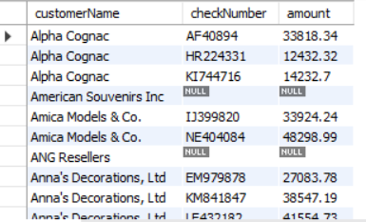
OUTER JOIN
Outer Join Results
Unlike INNER join, this will include customer rows with no matching order rows
Notes:
There are 15 records in the Customer_T table, so all of these are returned, even if there are no matching records in the Order_T table. Also, one of the customers has two orders, as you can see. Therefore there are total of 16 rows returned here.
This is what distinguishes an outer join from an inner join.

Slide 29
Structure of SQL statements

Slide 30
Regular expression
Search for a string not containing specified characters
[^a-f] means any character not in the set containing a, b, c, d, e, or f
This means the string 'abcdefg' will be reported because it contains a 'g', which is not in a-f
List the names of nations with non-alphabetic characters in their names
SELECT * FROM nation
WHERE natname REGEXP '[^a-z|A-Z]'

Slide 31
Regular expression
Search for a column not containing a specified character in any position in the column
^[^x]*$ means any character (*) from the first (^) through the last ($) is not x [^x]
List the names of nations without s or S anywhere in their names
SELECT * FROM nation WHERE natname REGEXP '^[^s|S]*$'

Slide 32
Regular expression
Search for a string containing a repetition
{n} means repeat the pattern n times
List the names of firms with a double ‘e’.
SELECT * FROM stock
WHERE stkfirm REGEXP '[e]{2}'

Slide 33
Regular expression
Search for a string containing several different specified strings
| means alternation (or)
List the names of firms with a double ‘s’ or a double ‘n’.
SELECT * FROM stock
WHERE stkfirm REGEXP '[s]{2}|[n]{2}'

Slide 34
Regular expression
Search for multiple versions of a string
[ea] means any character from the set containing e and a
It will match for ‘e’ or ‘a’
List the names of firms with names that include ‘inia’ or ‘onia’.
SELECT * FROM stock
WHERE stkfirm REGEXP '[io]nia'

Slide 35
Regular expression
Find firms with ‘t’ as the third letter of their name.
SELECT shrfirm FROM share
WHERE shrfirm REGEXP '^(.){2}t';
Find firms not containing an ‘s’ in their name.
SELECT shrfirm FROM share
WHERE shrfirm NOT REGEXP 's|S';

Slide 36
regexlib.com
A library of regular expressions
Cheat sheet for creating expressions

Slide 37
Exercise
Report the names of nations starting with ‘United’

Slide 38
Practice Exercise 1.4
Based on the ClassicModels database
List the names of customers who have requested that they orders be shipped via DHL or FedEx
List the names of those products that have opening hood and opening doors in their description

Slide 39
Subqueries
A query nested within another query
Report the names of all Australian stocks.
SELECT stkfirm FROM stock
WHERE natcode IN
(SELECT natcode FROM nation WHERE natname = 'Australia');
stkfirm
Narembeen Emu
Queensland Diamond
Indooroopilly Ruby

Slide 40
Correlated subquery
Solves the inner query many times
Find those stocks where the quantity is greater than the average for that country.
SELECT natname, stkfirm, stkqty FROM stock JOIN nation
ON stock.natcode = nation.natcode
AND stkqty >
(SELECT AVG(stkqty) FROM stock
WHERE stock.natcode = nation.natcode);
Correlated subqueries can be resource intensive
natname | stkfirm | stkqty
Australia | Queensland Diamond | 89251
United Kingdom | Bolivian Sheep | 231678
United Kingdom | Royal Ostrich Farms | 1234923
United States | Minnesota Gold | 816122

Slide 41
Correlated subquery
SELECT natname, stkfirm, stkqty FROM stock JOIN nation
ON stock.natcode = nation.natcode
WHERE stkqty >
(SELECT AVG(stkqty) FROM stock
WHERE stock.natcode = nation.natcode);
Stock |  |  |  |  |  |  |  | Nation
stkcode | stkfirm | stkprice | stkqty | stkdiv | stkpe | natcode |  | natcode | natname | exchrate
NE | Narembeen Emu | 12.34 | 45619 | 1.00 | 8 | AUS |  | AUS | Australia | 0.46000
IR | Indooroopilly Ruby | 15.92 | 56147 | 0.50 | 20 | AUS |  | AUS | Australia | 0.46000
QD | Queensland Diamond | 6.73 | 89251 | 0.50 | 7 | AUS |  | AUS | Australia | 0.46000
BD | Bombay Duck | 25.55 | 167382 | 1.00 | 12 | IND |  | IND | India | 0.02280
ROF | Royal Ostrich Farms | 33.75 | 1234923 | 3.00 | 6 | UK |  | UK | United Kingdom | 1.00000
CS | Canadian Sugar | 52.78 | 4716 | 2.50 | 15 | UK |  | UK | United Kingdom | 1.00000
FC | Freedonia Copper | 27.50 | 10529 | 1.84 | 16 | UK |  | UK | United Kingdom | 1.00000
BS | Bolivian Sheep | 12.75 | 231678 | 1.78 | 11 | UK |  | UK | United Kingdom | 1.00000
BE | Burmese Elephant | 0.07 | 154713 | 0.01 | 3 | UK |  | UK | United Kingdom | 1.00000
ILZ | Indian Lead & Zinc | 37.75 | 6390 | 3.00 | 12 | UK |  | UK | United Kingdom | 1.00000
SLG | Sri Lankan Gold | 50.37 | 32868 | 2.68 | 16 | UK |  | UK | United Kingdom | 1.00000
AR | Abyssinian Ruby | 31.82 | 22010 | 1.32 | 13 | UK |  | UK | United Kingdom | 1.00000
PT | Patagonian Tea | 55.25 | 12635 | 2.50 | 10 | UK |  | UK | United Kingdom | 1.00000
NG | Nigerian Geese | 35.00 | 12323 | 1.68 | 10 | UK |  | UK | United Kingdom | 1.00000
MG | Minnesota Gold | 53.87 | 816122 | 1.00 | 25 | US |  | US | United States | 0.67000
GP | Georgia Peach | 2.35 | 387333 | 0.20 | 5 | US |  | US | United States | 0.67000

Slide 42
Subquery vs. Correlated Subquery
In a “regular” subquery, the inner query is executed once.
SELECT shrfirm, shrpe
FROM shr
WHERE shrpe >(SELECT AVG(shrpe)FROM shr);
In a “correlated” subquery, the inner query is executed many times.
SELECT natname, stkfirm, stkqty
FROM stock, nation
WHERE stock.natcode = nation.natcode
AND stkqty >
(SELECT AVG(stkqty) FROM stock
WHERE stock.natcode = nation.natcode);
But why?

Slide 43
Exercise
Report the country, firm, and stock holding for the maximum quantity of stock held for each country

Slide 44
Class Exercise 4
Assume two entities with a 1:m relationship
Source
*Source_ID
Source_chef_f_name
Source_chef_l_name
Source_website
Recipe
*Rec_ID
Rec_category
Rec_name
Rec_level
Rec_prep_time
Rec_inact_prep_time
Rec_cook_time
Write a query to
Display the recipe name, prep time and source website for those recipes whose prep time is less than the average prep time for all recipes.
What would be different about the Recipe table?
An FK present! Source_ID

Slide 45
Practice Exercise 4
Assume two entities with a 1:m relationship
Write a query to
Display the recipe name, prep time, and source website for those recipes whose prep time is less than the average prep time of the recipes from that same source.
Source
*Source_ID
Source_chef_f_name
Source_chef_l_name
Source_website
Recipe
*Rec_ID
Rec_category
Rec_name
Rec_level
Rec_prep_time
Rec_inact_prep_time
Rec_cook_time

Slide 46
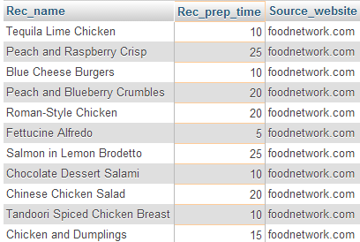
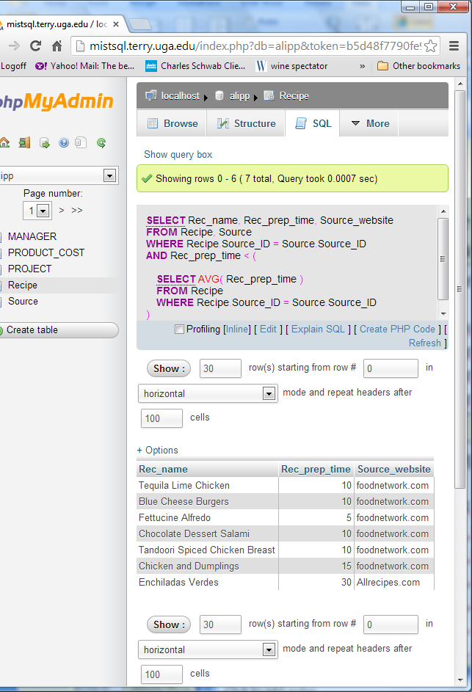
Comparing a Nested Query (Subquery) with a Correlated Subquery
SELECT Rec_name, Rec_prep_time, Source_website
FROM Recipe, Source
WHERE Recipe.Source_ID = Source.Source_ID
AND Rec_prep_time <
(SELECT AVG(Rec_prep_time)
FROM Recipe)
SELECT Rec_name,Rec_prep_time, Source_website
FROM Recipe, Source
WHERE Recipe.Source_ID = Source.Source_ID
AND Rec_prep_time <
(SELECT AVG(Rec_prep_time)
FROM Recipe
WHERE Recipe.Source_ID = Source.Source_ID)

Slide 47
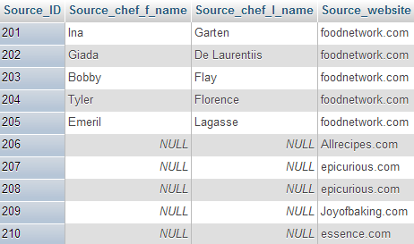
Table Source

Slide 48
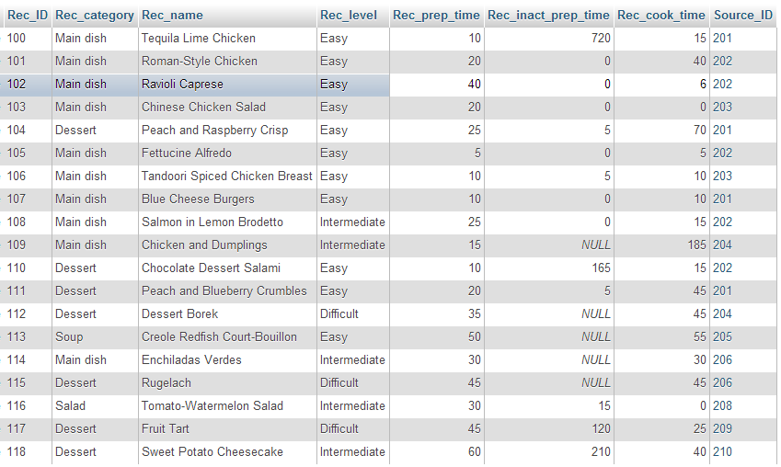
Table Recipe
Foreign Key

Slide 49
Practice Exercise 1.5
Use the ClassicModels database (Customer/Payments tables), write queries to
Print out the customer name, contact information and the number of checks that the customer has written.
Print out customer name, contact information, check number and amount for those checks that were greater than the average amount of the check payments.
Print out customer name, contact information, check number and amount for those checks that were greater than the average amount of the check payments for that customer.

Slide 50
Views - virtual tables
An imaginary table constructed by the DBMS when required
Only the definition of the view is stored, not the result
CREATE VIEW stkvalue
(nation, firm, price, qty, exchrate, value)
AS SELECT natname, stkfirm, stkprice, stkqty, exchrate,
stkprice*stkqty*exchrate
FROM stock JOIN nation
ON stock.natcode = nation.natcode;
Notes:
Added to MySQL 5.0.1

Slide 51
Views - querying
Query exactly as if a table
SELECT nation, firm, value FROM stkvalue WHERE value > 100000;
nation | firm | value
United Kingdom | Freedonia Copper | 289547.50
United Kingdom | Patagonian Tea | 698083.75
United Kingdom | Abyssinian Ruby | 700358.20
United Kingdom | Sri Lankan Gold | 1655561.16
United Kingdom | Indian Lead & Zinc | 241222.50
United Kingdom | Bolivian Sheep | 2953894.50
United Kingdom | Nigerian Geese | 431305.00
United Kingdom | Canadian Sugar | 248910.48
United Kingdom | Royal Ostrich Farms | 41678651.25
United States | Minnesota Gold | 29456209.73
United States | Georgia Peach | 609855.80
Australia | Narembeen Emu | 258951.69
Australia | Queensland Diamond | 276303.24
Australia | Indooroopilly Ruby | 411175.71

Slide 52
Why create a view?
Simplify query writing
Calculated columns
Security
Restrict access to parts of a table

Slide 53
Exercise
Create a view for dividend payment

Slide 54
Practice Exercise 5 Review of Group By and Having
Assume two entities with a 1:m relationship
Write a query to
Count the number of recipes in each recipe category. Display the recipe category and count.
Display the recipe category and number of recipes in that category. Display only those categories for which the count is >2.
Source
*Source_ID
Source_chef_f_name
Source_chef_l_name
Source_website
Recipe
*Rec_ID
Rec_category
Rec_name
Rec_level
Rec_prep_time
Rec_inact_prep_time
Rec_cook_time

Slide 55
Summary
New topics
1:m relationship
Foreign key
Correlated subquery
GROUP BY
HAVING clause
View

Slide 56
Data Modelling Exercise
An art researcher has asked you to design a database to record details of artists and the museums in which their paintings are displayed. For each painting, the researcher wants to know the size of the canvas, year painted, title, and style. The nationality, date of birth, and death of each artist must be recorded . For each museum, record details of its location and specialty, if it has one.

